Slide 1
R Hive Technical Document

Slide 2
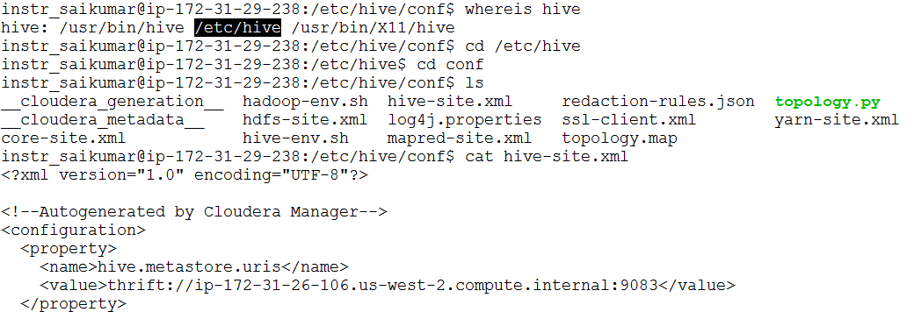
Hive Server IP Address
Run the following commands:
1. whereis hive
2. cd /etc/hive
3. ls
4. cd conf
5. cat hive-site.xml
6. Check for this property, and copy the ip address(highlighted) of hive metastore:
<property>
<name>hive.metastore.uris</name>
<value>thrift://ip-172-31-26-106.us-west-2.compute.internal:9083</value>
</property>

Slide 3
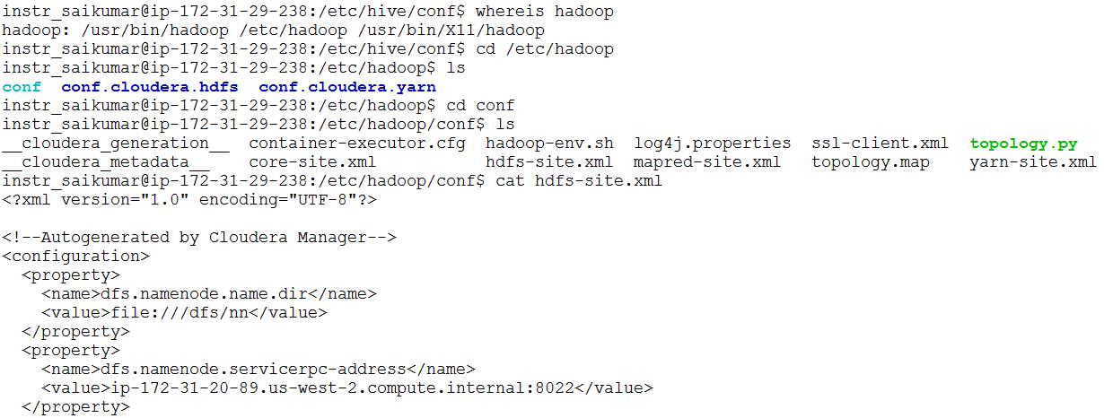
HDFS Namenode IP Address
1. whereis hadoop
2. cd /etc/hadoop
3. cd conf
4. ls
5. cat hdfs-site.xml
6. Check for this property, and copy the ip address(highlighted) of hive metastore:
<property>
<name>dfs.namenode.servicerpc-address</name>
<value>ip-172-31-20-89.us-west-2.compute.internal:8022</value>
</property>

Slide 4
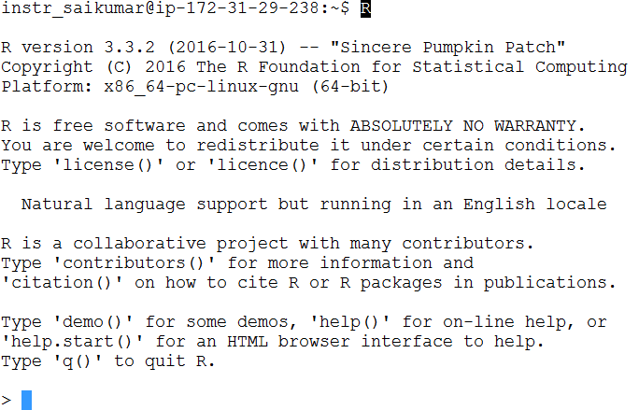
Login to R Interactive Session

Slide 5
Instructions for this Lab
1. Lab happens in terminal mode.
2. To get the best out of this lab, it is better you type commands instead of copy/paste.
3. Make sure you change the configurations of hive server and HDFS namenode location.
4. Images cannot be rendered on terminals, to see the plots, save it on remote cluster. Now using Filezilla or Winscp, transfer it to your local machine. Open and check it.
5. After creating and loading tables with data, check Hive from HUE. Connect to your database, and see if tables are created.

Slide 6
You will learn the following
script1:
1. Load R Libraries
2. Connect to R
3. Create table and load data in to hive from R
4. R Hive Integration
Script2,3,4:
1. Create table and load data in to hive from R
2. Summary and structure of dataframes
Script 5,6,9,10:
1. Data Visualization
2. Line Plots
3. Pie Charts
4. Save plots
Script 7,8,11,12,13,14:
1. Create table and load data in to hive from R
2. Aggregations on hive
3. Order/sort data
4. Group operations on hive
5. Sub Queries
6. Where and Having

